Slide 1
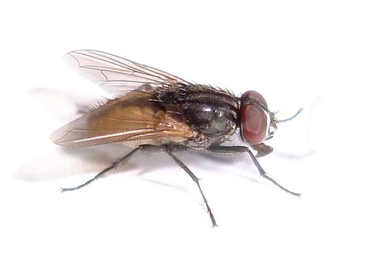
ሀ
This Photo by Unknown Author is licensed under CC BY

Slide 2
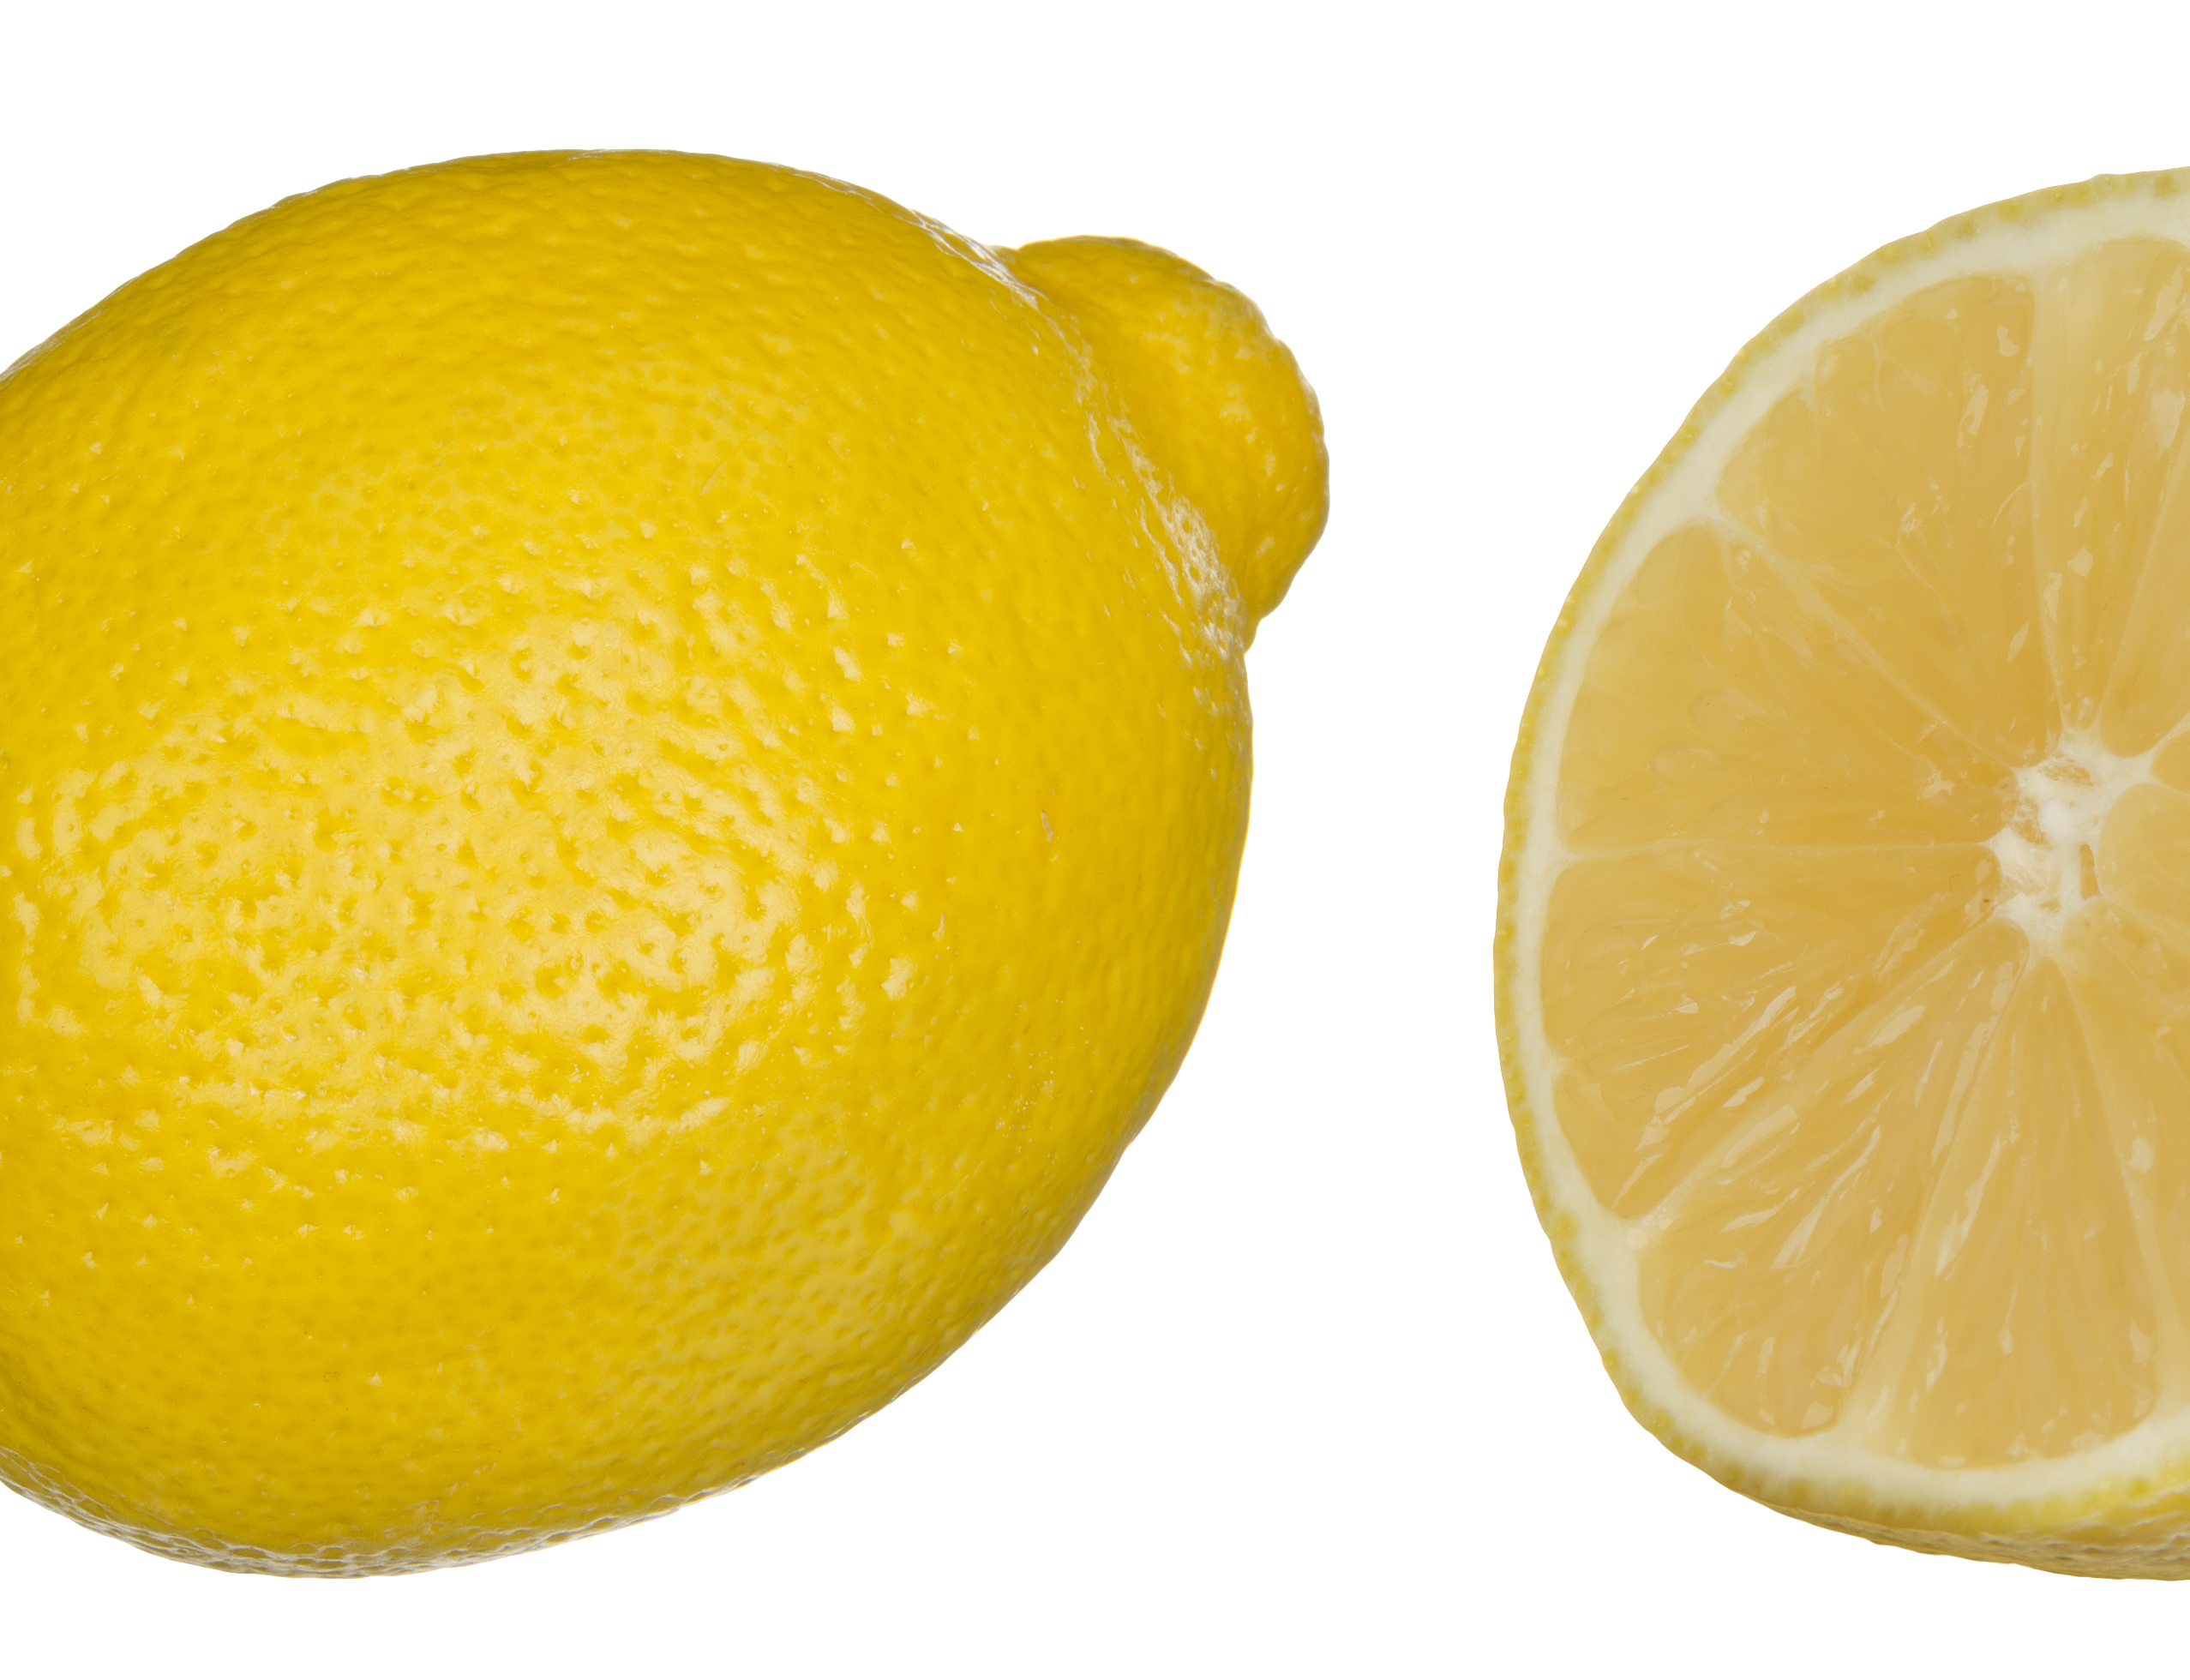
ለ
This Photo by Unknown Author is licensed under CC BY-SA

Slide 3
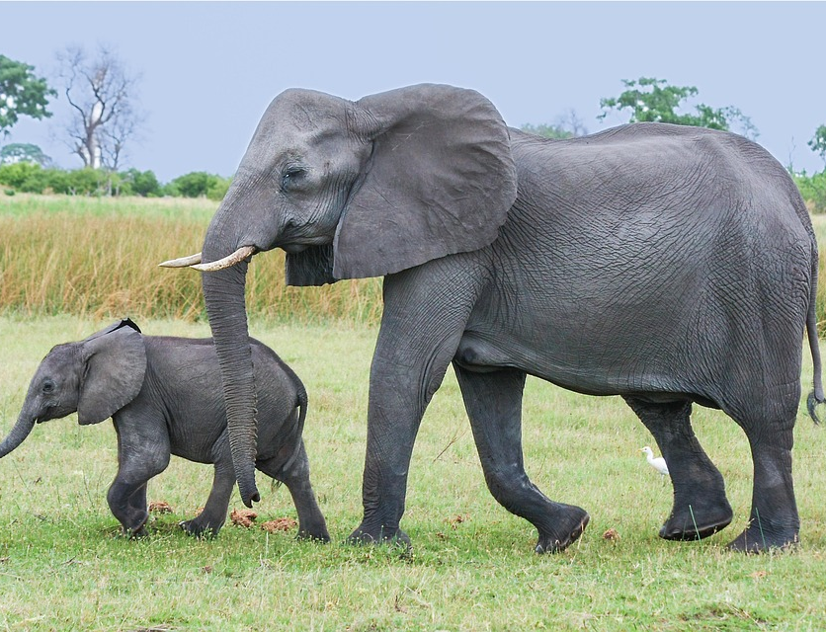
ሐ

Slide 4
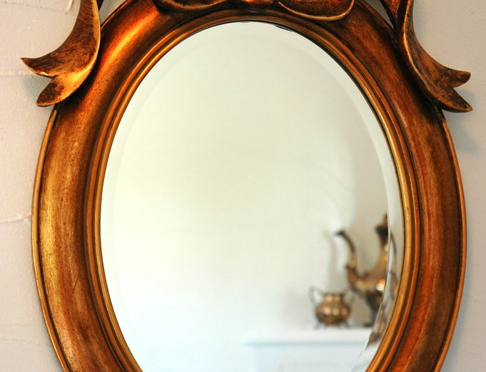
መ

Slide 5
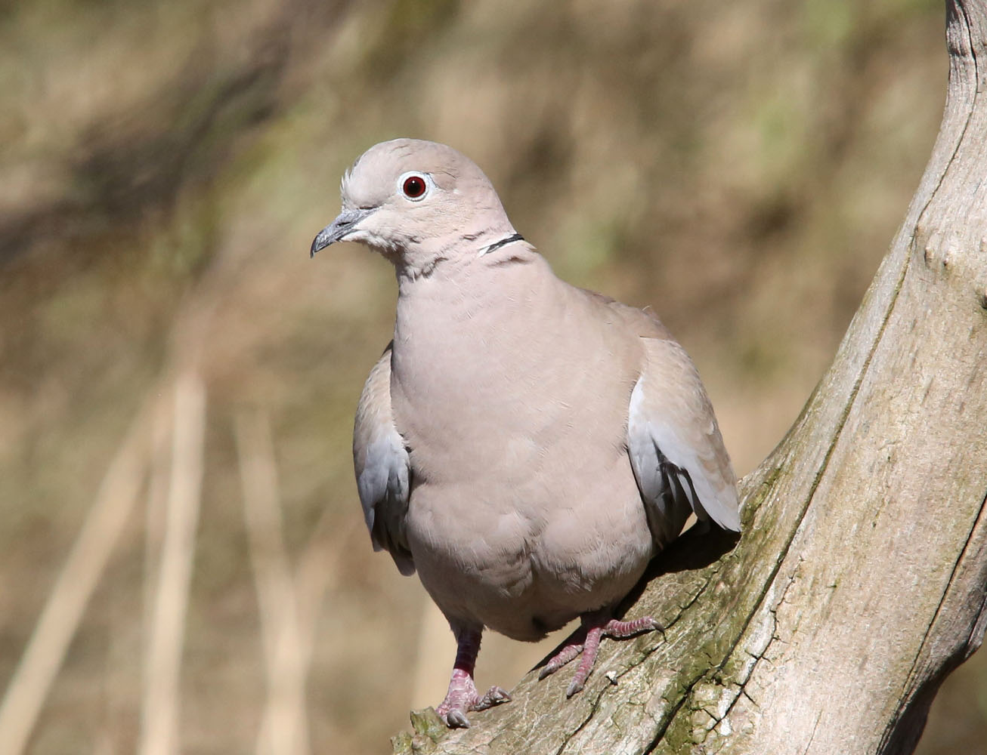
ረ
This Photo by Unknown Author is licensed under CC BY-SA-NC

Slide 6
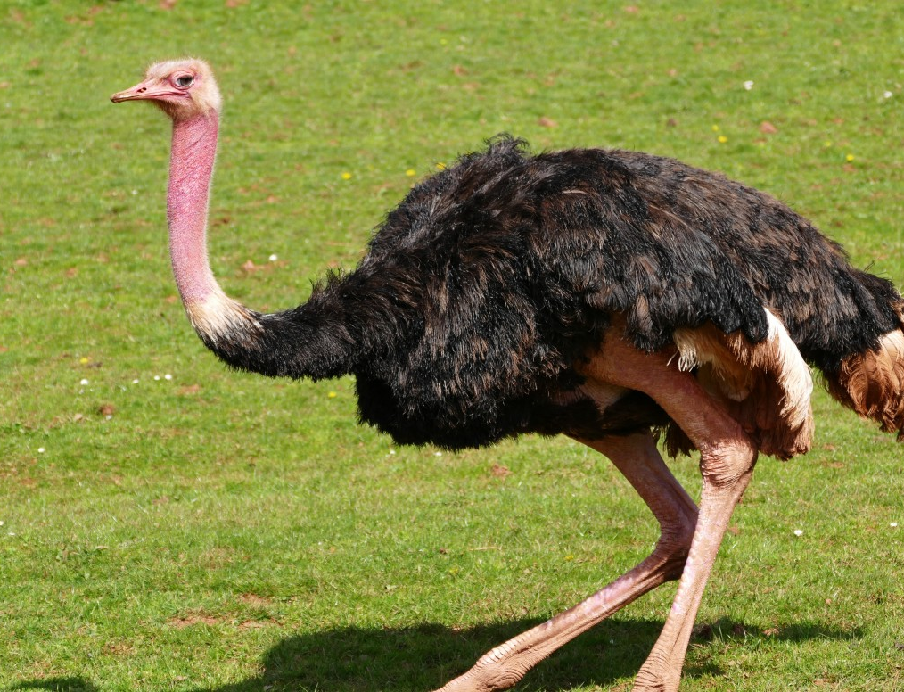
ሰ

Slide 7

ሸ

Slide 8

ቀ

Slide 9
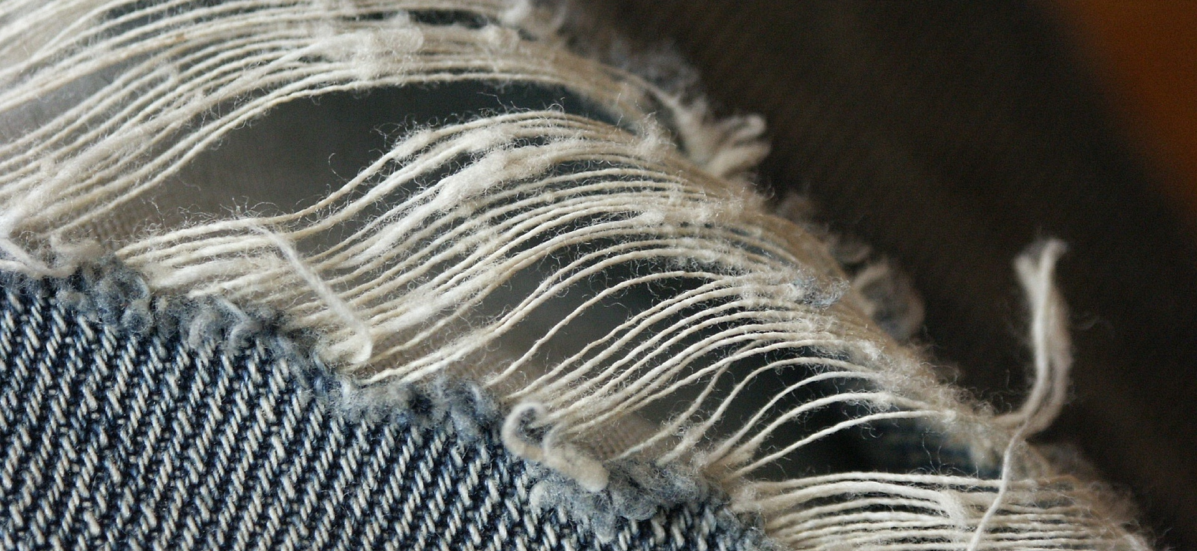

ቐ

Slide 10
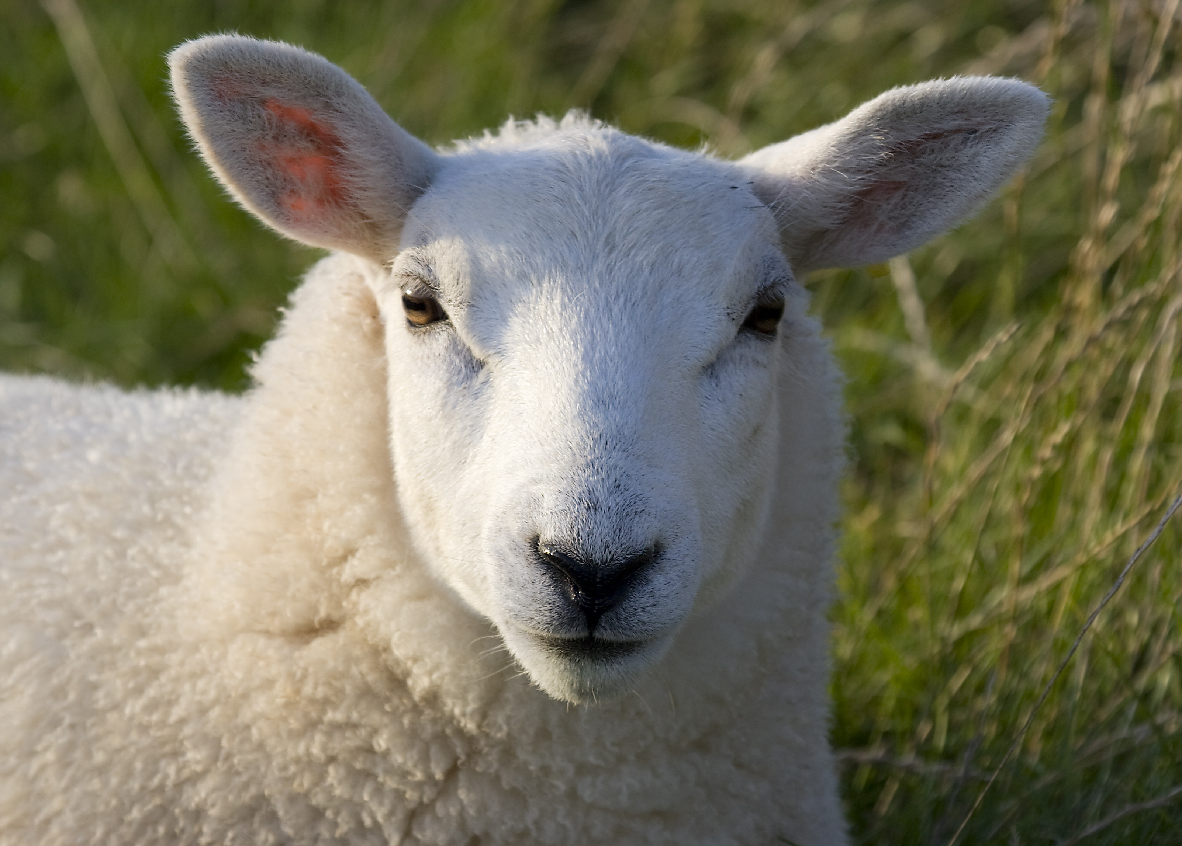
በ

Slide 11
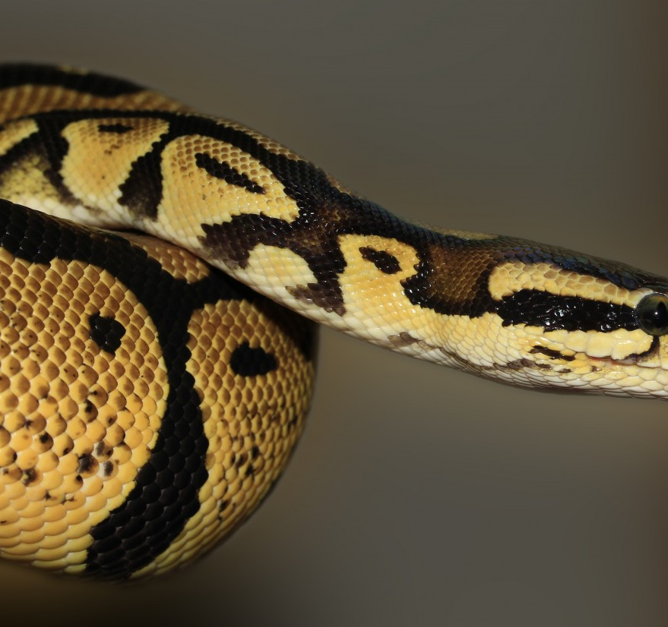
ተ

